Slide 1
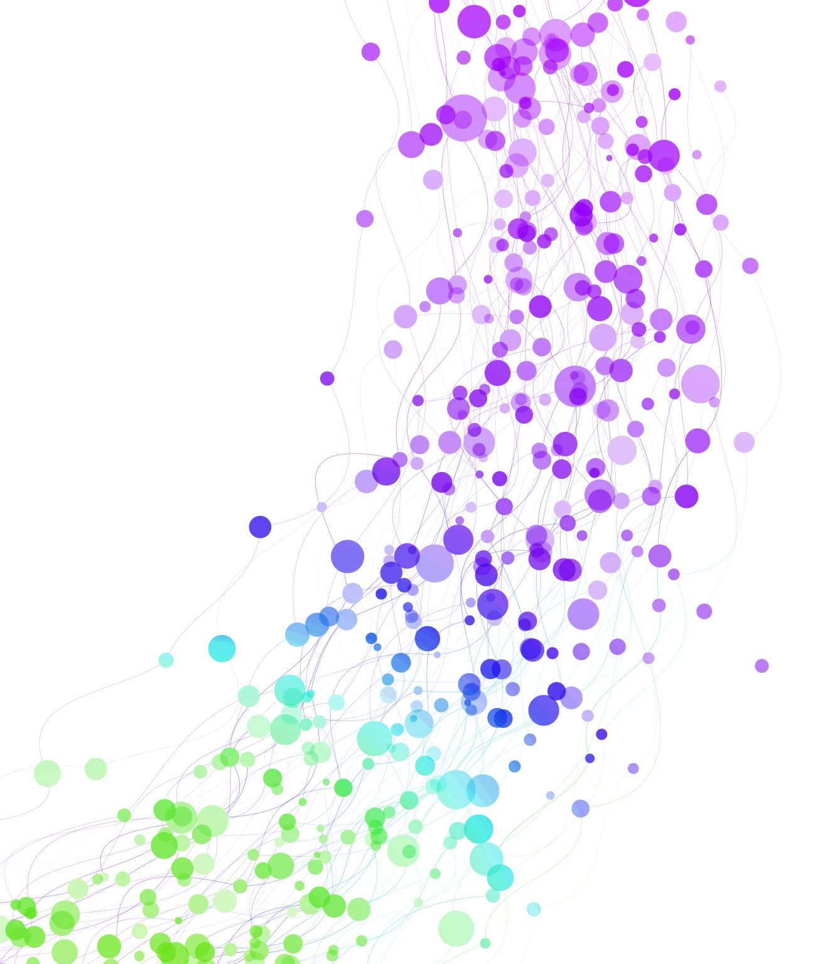
Federated Learning approach for severity classification of Knee Osteoarthritis
21BAI1398 – Burlagadda Sai Nikhil
21BAI1553 – Gondi Vidya Bhavana
21BAI1442 – Riya Nitin Taori
Guide: Dr Amutha S

Slide 2
Introduction
Knee Osteoarthritis: Knee osteoarthritis (OA) is a degenerative joint disease-causing cartilage breakdown in the knee, leading to pain, stiffness, and reduced mobility. It is commonly diagnosed through imaging, and effective management is essential to improve patient quality of life.
Challenges in the present system: Privacy concerns in centralized medical data collection.
Solution: Federated Learning (FL) allows model training across institutions while keeping data localized.
Proposed Technique: To classify the severity of knee osteoarthritis (OA) from X-ray images using Federated Learning, ensuring data privacy while achieving high model performance.
Federated Learning: A distributed learning approach where multiple clients train a model collaboratively without sharing raw data.
Significance: Maintains Data Privacy and enables collaborative model improvement across institutions.

Slide 3
Problem Statement
The conventional detection of knee osteoarthritis (OA) involves multiple tests and detailed examination by skilled physicians, making it time-intensive and prone to misclassification due to subtle differences in X-ray images. Privacy concerns also restrict the sharing of sensitive data like medical X-rays, while traditional machine learning methods require centralized data collection, further compromising data privacy. There is a critical need for a technology that enables accurate OA severity classification from X-ray images without compromising patient data privacy. Federated Learning addresses this by enabling model training on decentralized data, ensuring privacy and enhancing diagnostic accuracy.

Slide 4
Research Objective
Develop a reliable, privacy-preserving model to classify the severity of knee osteoarthritis (OA) using X-ray images.
Leverage Federated Learning to enable collaborative model training on decentralized medical data, minimizing the need for centralized data collection and ensuring patient data privacy.
Implement and compare the performance of advanced deep learning architectures, specifically DenseNet201 and InceptionResNetV2, to determine the most effective model for OA severity classification.
Evaluate the effectiveness of the FedAverage algorithm for model aggregation across multiple clients, while employing Xavier Glorot Weight Initialization to enhance model convergence.
Assess the model’s classification accuracy across three OA severity levels (Healthy, Moderate, Severe) and validate the feasibility of Federated Learning in real-world medical imaging applications.

Slide 5
Proposed System Introduction
The proposed system aims to classify Knee Osteoarthritis (OA) severity from X-ray images in a decentralized, privacy-preserving manner using Federated Learning (FL).
Key Features:
1. Federated Learning (FL): Allows collaborative model training across multiple client datasets without centralizing data, ensuring patient privacy.
2. Model Selection: Utilizes advanced deep learning architectures, DenseNet201 and InceptionResNetV2, to achieve high accuracy in OA severity classification.
System Workflow:
1. Data Pre-processing: Normalization and augmentation techniques are applied to X-ray images to enhance model performance and generalization.
2. FL Setup: Three clients train local models on separate datasets, completing multiple communication rounds.
3. Model Aggregation: Uses the FedAverage algorithm to combine client models into a global model, with Xavier Glorot Weight Initialization for stable convergence.

Slide 6
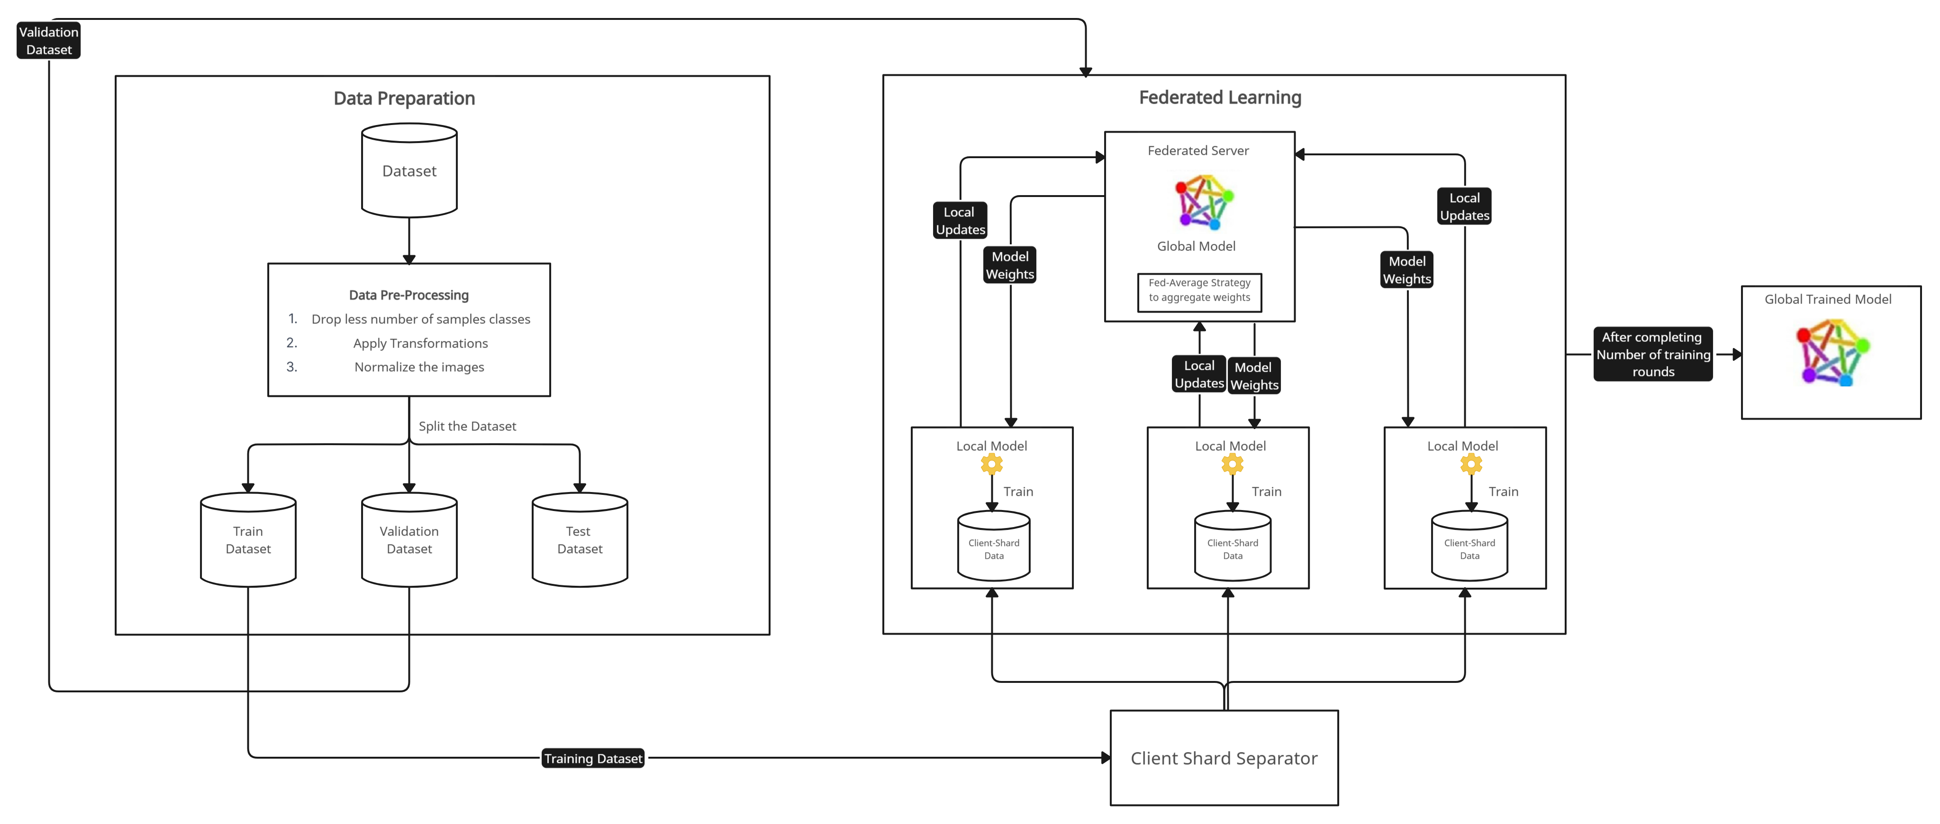
Proposed System Diagram

Slide 7
List of Modules Used
Data Loading and Pre-processing module
Model Architecture module
Data Partitioning and Client Simulation Module
Federated Learning setup module
Training and Evaluation module
Utilities and Configuration module

Slide 8
Explanation of Modules
Data Loading and Pre-processing Module:
Custom Dataset Class: Defines a custom dataset class ( CustomImageDataset ) to manage the loading and preprocessing of X-ray images. It handles directory structure, image transformation, and class labeling to make the dataset compatible with the model.
Transformations: The module includes standard image transformations (e.g., resizing, normalization) to enhance the model training performance

Slide 9
Explanation of Modules
Model Architecture Module:
Model Selection: Leverages PyTorch’s pre-trained architectures, DenseNet201 as foundational model. This architecture is selected to capture the complex patterns in X-ray images.
Weight Initialization: Uses Xavier Glorot Initialization to set initial weights, ensuring stable and efficient training.

Slide 10
Explanation of Modules
Data Partitioning and Client Simulation Module:
Client Data Distribution: Partitions the dataset among clients to simulate decentralized data storage. Each client receives a unique subset of the data, preserving the local and distributed nature of Federated Learning.
Client Simulation: Mimics the real-world client behavior (e.g., hospitals or clinics), allowing each client to train a local model without sharing data, which is crucial for privacy and simulating realistic FL environments.

Slide 11
Explanation of Modules
Federated Learning Setup Module:
Client and Round Configuration: Setup multiple clients and a specified number of rounds for Federated Learning. This module coordinates the decentralized training process and defines each client’s role.
Federated Averaging: Implements the FedAverage algorithm for aggregating model updates from each client, ensuring an optimized global model data without data centralization.

Slide 12
Explanation of Modules
Training and Evaluation Module:
Training Loop: Handles the core training process, where the model is iteratively trained on each client’s data, performs weight updates, and applies Federated Averaging after each round.
Evaluation Metrics: Integrates performance metrics such as classification reports and confusion metrices to assess accuracy across severity classes (Healthy, Moderate and Severe)

Slide 13
Explanation of Modules
Utilities and Configuration Module:
Seed Setup: Sets a random seed to ensure reproducibility in model training and evaluation, making experiments consistent.
Device Configuration: Identifies the device ( GPU or CPU ) for model training, improving computation efficiency.

Slide 14
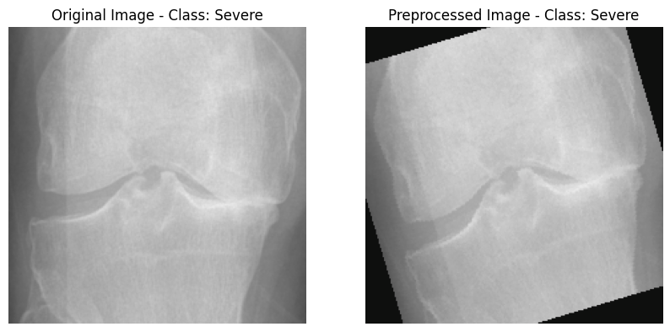
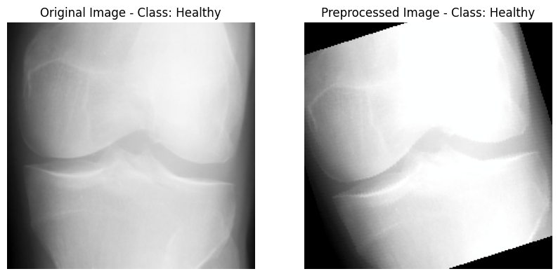
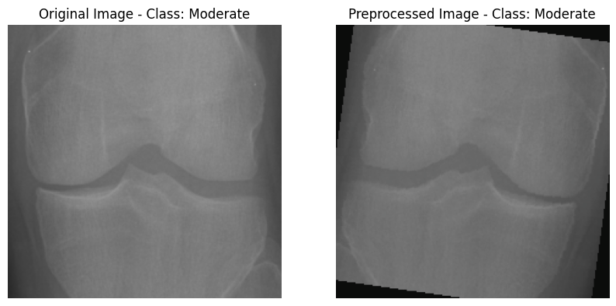
Implementation Results
Normal and Pre-Processed Images:

Slide 15
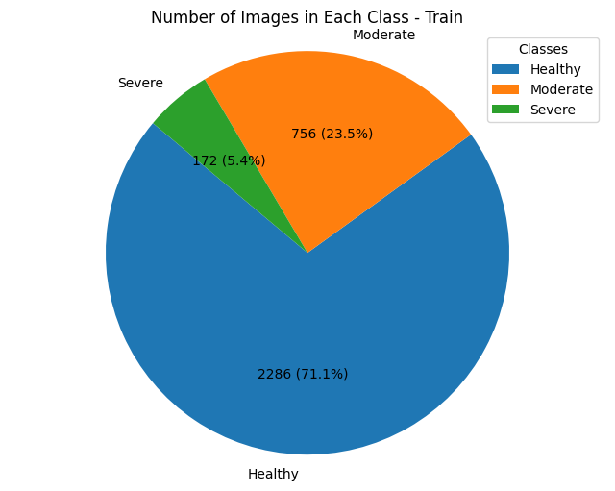

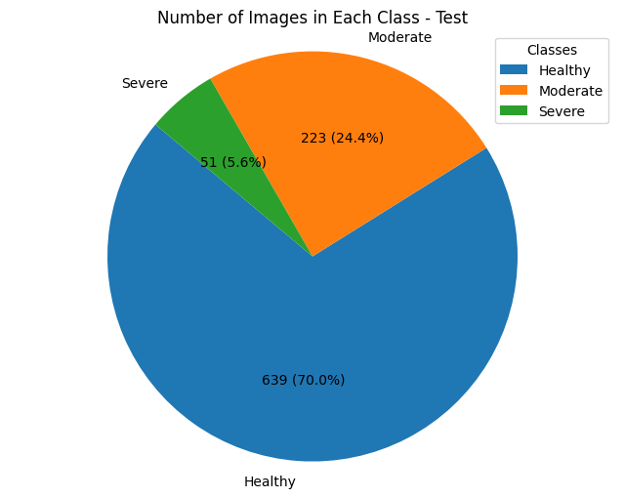
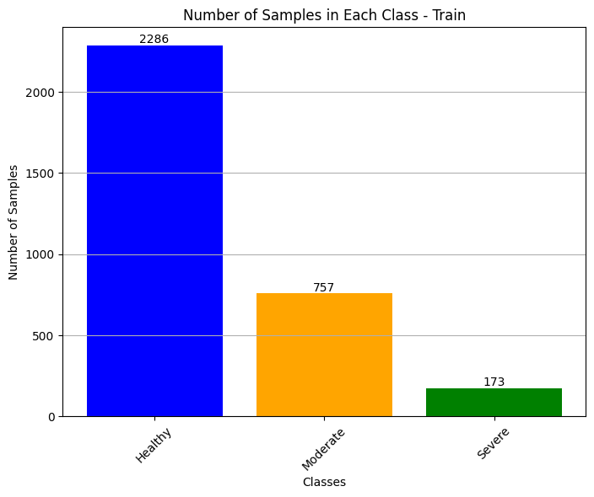
Implementation Results
Exploratory Data Analysis

Slide 16
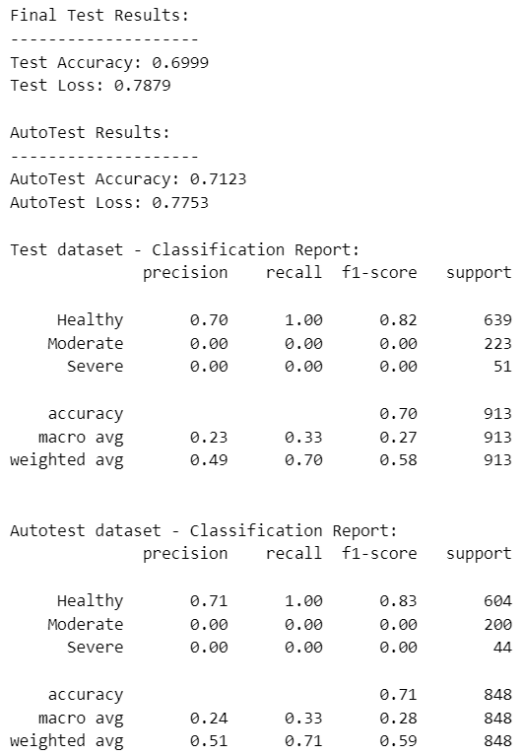
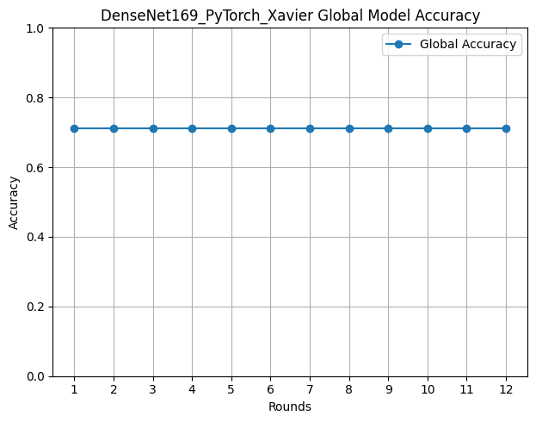
Implementation Results – Xavier Initialization
Results:
VGG16 Model:
Classification Report: Accuracy Plot:

Slide 17
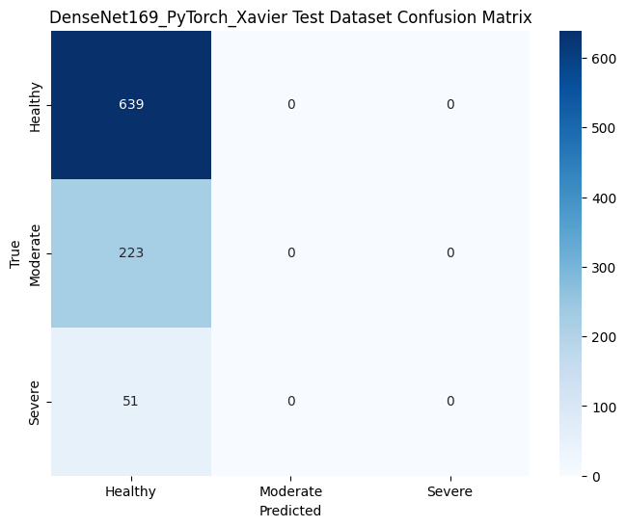
Implementation Results – Xavier Initialization
Results:
VGG16 Model:
Confusion Matrix:

Slide 18
Implementation Results – Xavier Initialization
Results:
VGG16 Model:
Federated Learning Metrics:
Federated Learning Metrics:
Final Metrics:
Global Accuracy : 69.99 %
Global Loss : 0.7879
Round | Accuracy | Loss
1 | 71.15 % | 1.04
2 | 71.15 % | 0.92
3 | 71.15 % | 0.84
4 | 71.15 % | 0.84
5 | 71.15 % | 0.84
6 | 71.15 % | 0.82
Round | Accuracy | Loss
7 | 71.15 % | 0.82
8 | 71.15 % | 0.82
9 | 71.15 % | 0.82
10 | 71.15 % | 0.82
11 | 71.15 % | 0.82
12 | 71.15 % | 0.82

Slide 19
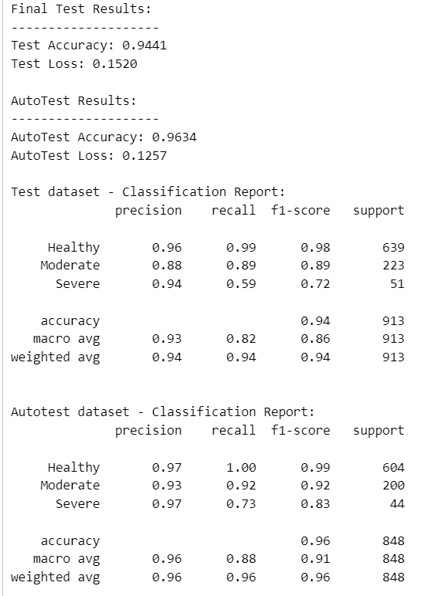
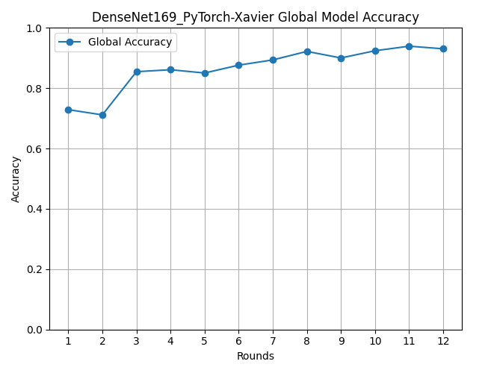
Implementation Results – Xavier Initialization
Results:
DenseNet169 Model:
Classification Report: Accuracy Plot:

Slide 20
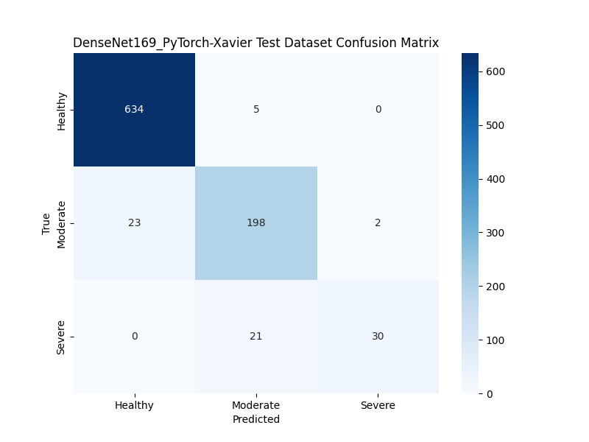
Implementation Results – Xavier Initialization
Results:
DenseNet169 Model:
Confusion Matrix:

Slide 21
Implementation Results – Xavier Initialization
Results:
DenseNet169 Model:
Federated Learning Metrics:
Federated Learning Metrics:
Final Metrics:
Global Accuracy : 94.41 %
Global Loss : 0.1520
Round | Accuracy | Loss
1 | 72.89 % | 0.90
2 | 71.15 % | 0.78
3 | 85.47 % | 0.39
4 | 86.12 % | 0.38
5 | 85.03 % | 0.33
6 | 87.64 % | 0.32
Round | Accuracy | Loss
7 | 89.37 % | 0.32
8 | 92.19 % | 0.26
9 | 90.02 % | 0.33
10 | 92.41 % | 0.23
11 | 93.93 % | 0.20
12 | 93.06 % | 0.21

Slide 22
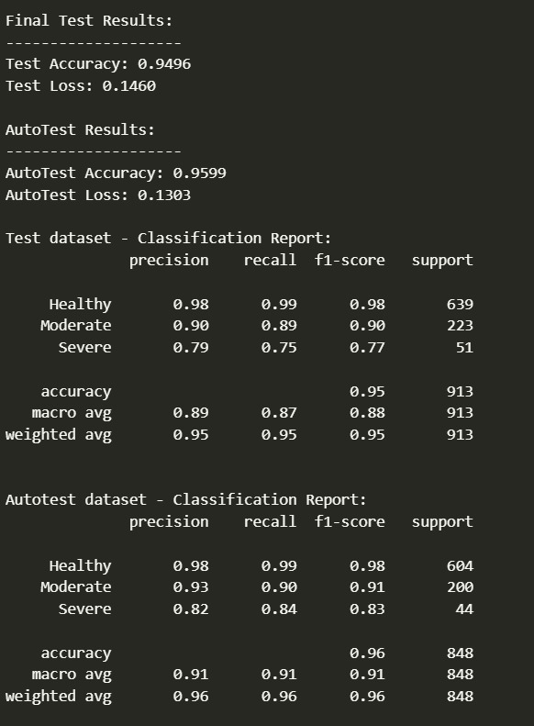
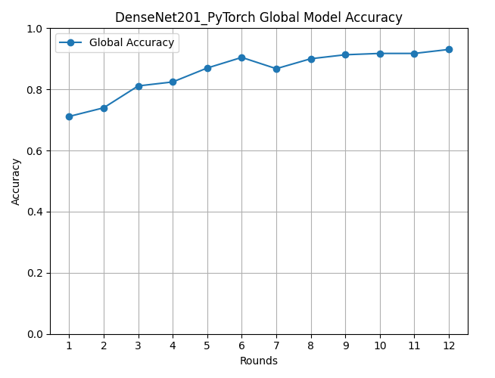
Implementation Results – Xavier Initialization
Results:
DenseNet201 Model:
Classification Report: Accuracy Plot:

Slide 23
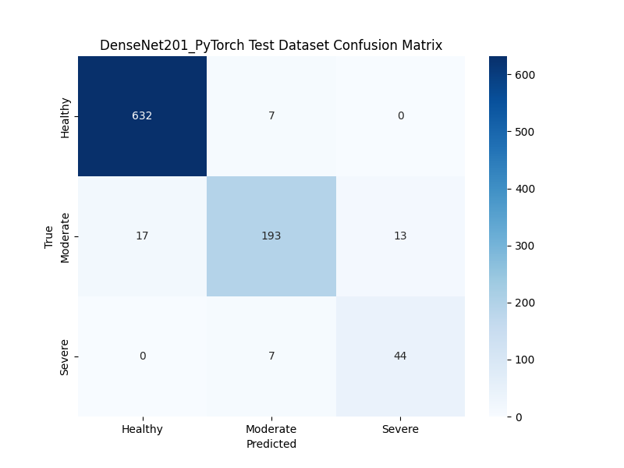
Implementation Results – Xavier Initialization
Results:
DenseNet201 Model:
Confusion Matrix:

Slide 24
Implementation Results – Xavier Initialization
Results:
DenseNet201 Model:
Federated Learning Metrics:
Federated Learning Metrics:
Final Metrics:
Global Accuracy : 94.96 %
Global Loss : 0.1460
Round | Accuracy | Loss
1 | 71.15 % | 0.91
2 | 73.97 % | 0.74
3 | 81.13 % | 0.49
4 | 82.43 % | 0.43
5 | 86.99 % | 0.33
6 | 90.46 % | 0.31
Round | Accuracy | Loss
7 | 86.77 % | 0.33
8 | 90.02 % | 0.30
9 | 91.32 % | 0.27
10 | 91.76 % | 0.25
11 | 91.76 % | 0.25
12 | 93.06 % | 0.24

Slide 25
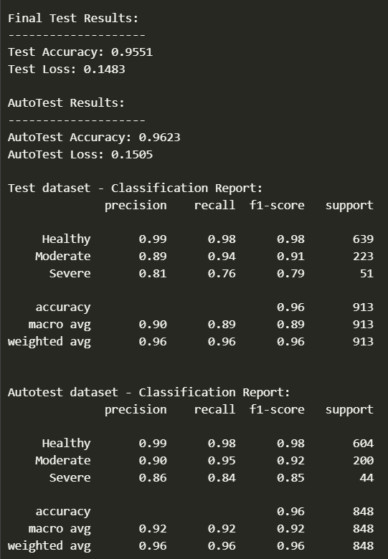
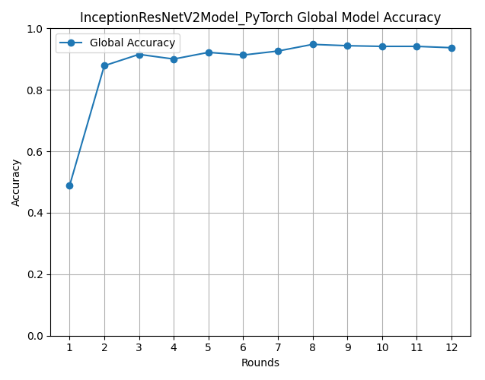
Implementation Results – Xavier Initialization
Results:
InceptionResNetV2 Model:
Classification Report: Accuracy Plot:

Slide 26

Implementation Results – Xavier Initialization
Results:
InceptionResNetV2 Model:
Confusion Matrix:

Slide 27
Implementation Results – Xavier Initialization
Results:
InceptionResNetV2 Model:
Federated Learning Metrics:
Federated Learning Metrics:
Final Metrics:
Global Accuracy : 95.53 %
Global Loss : 0.1483
Round | Accuracy | Loss
1 | 48.81 % | 0.95
2 | 87.85 % | 0.36
3 | 91.54 % | 0.28
4 | 90.02 % | 0.28
5 | 92.19 % | 0.22
6 | 91.32 % | 0.28
Round | Accuracy | Loss
7 | 92.62 % | 0.21
8 | 94.79 % | 0.18
9 | 94.36 % | 0.19
10 | 94.14 % | 0.18
11 | 94.14 % | 0.16
12 | 93.71 % | 0.25

Slide 28
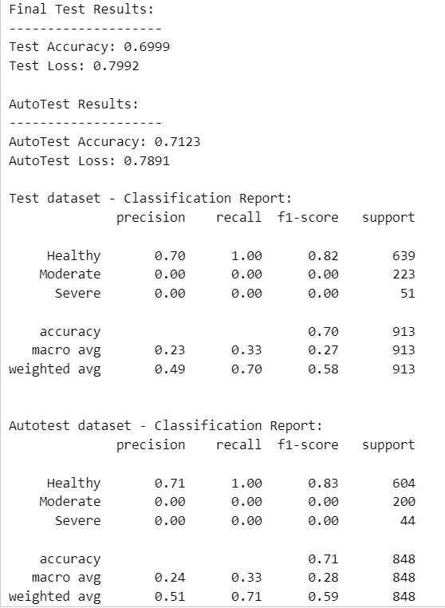

Implementation Results – without Xavier Initialization
Results:
VGG16 Model:
Classification Report: Accuracy Plot:

Slide 29

Implementation Results – without Xavier Initialization
Results:
VGG16 Model:
Confusion Matrix:

Slide 30
Implementation Results – Xavier Initialization
Results:
VGG16 Model:
Federated Learning Metrics:
Federated Learning Metrics:
Final Metrics:
Global Accuracy : 69.99 %
Global Loss : 0.7992
Round | Accuracy | Loss
1 | 71.15 % | 1.01
2 | 71.15 % | 0.83
3 | 71.15 % | 0.85
4 | 71.15 % | 0.84
5 | 71.15 % | 0.82
6 | 71.15 % | 0.83
Round | Accuracy | Loss
7 | 71.15 % | 0.83
8 | 71.15 % | 0.82
9 | 71.15 % | 0.82
10 | 71.15 % | 0.82
11 | 71.15 % | 0.83
12 | 71.15 % | 0.83

Slide 31
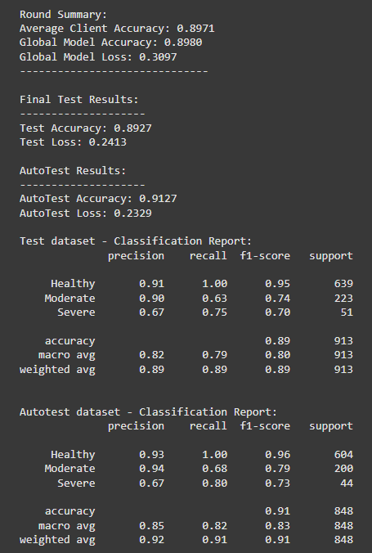
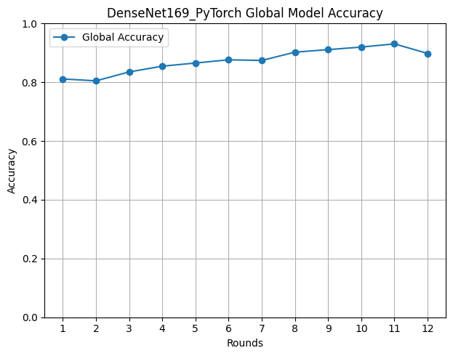
Implementation Results – without Xavier Initialization
Results:
DenseNet169 Model:
Classification Report: Accuracy Plot:

Slide 32
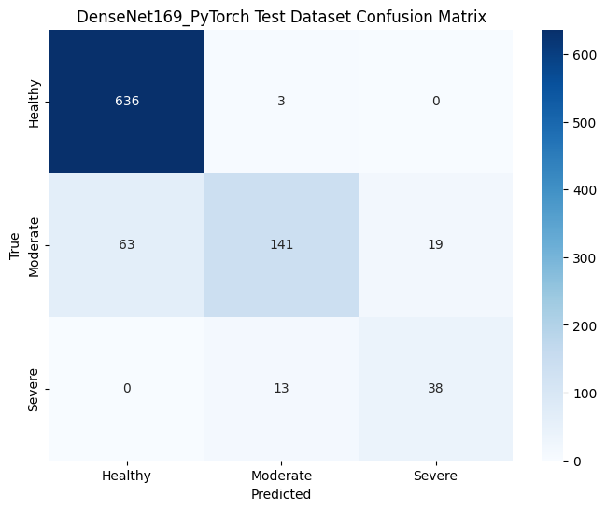
Implementation Results – without Xavier Initialization
Results:
DenseNet169 Model:
Confusion Matrix:

Slide 33
Implementation Results – without Xavier Initialization
Results:
DenseNet169 Model:
Federated Learning Metrics:
Federated Learning Metrics:
Final Metrics:
Global Accuracy : 89.27 %
Global Loss : 0.2413
Round | Accuracy | Loss
1 | 81.83 % | 0.88
2 | 80.48 % | 0.64
3 | 83.51 % | 0.56
4 | 85.47 % | 0.44
5 | 86.55 % | 0.37
6 | 87.64 % | 0.34
Round | Accuracy | Loss
7 | 87.42 % | 0.30
8 | 90.24 % | 0.31
9 | 91.11 % | 0.26
10 | 91.97 % | 0.24
11 | 93.06 % | 0.26
12 | 89.80 % | 0.30

Slide 34
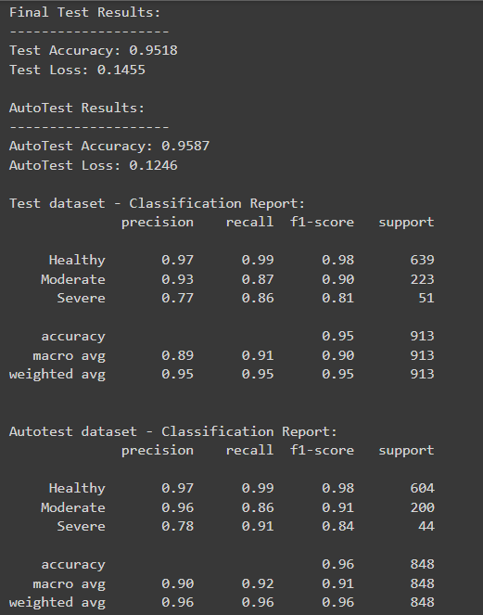
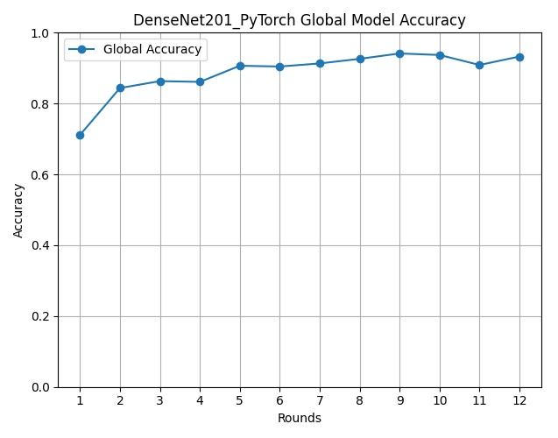
Implementation Results – without Xavier Initialization
Results:
DenseNet201 Model:
Classification Report: Accuracy Plot:

Slide 35

Implementation Results – without Xavier Initialization
Results:
DenseNet201 Model:
Confusion Matrix:

Slide 36
Implementation Results – without Xavier Initialization
Results:
DenseNet201 Model:
Federated Learning Metrics:
Federated Learning Metrics:
Final Metrics:
Global Accuracy : 95.18 %
Global Loss : 0.1450
Round | Accuracy | Loss
1 | 71.15 % | 0.89
2 | 84.38 % | 0.50
3 | 86.33 % | 0.42
4 | 86.12 % | 0.38
5 | 90.67 % | 0.31
6 | 90.46 % | 0.32
Round | Accuracy | Loss
7 | 91.32 % | 0.27
8 | 92.62 % | 0.28
9 | 94.14 % | 0.22
10 | 93.71 % | 0.21
11 | 90.89 % | 0.25
12 | 93.28 % | 0.20

Slide 37
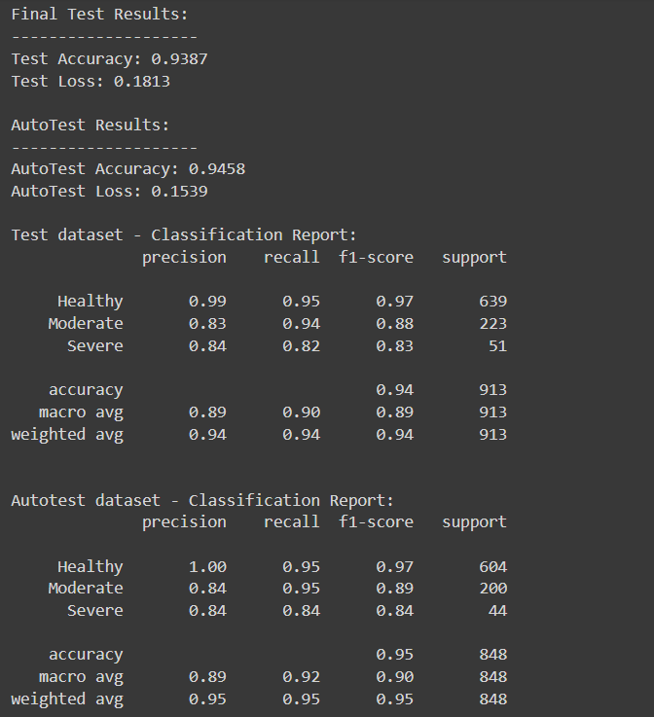
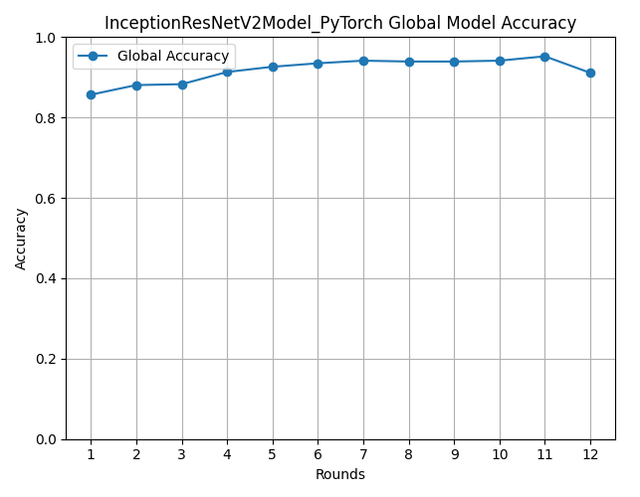
Implementation Results – without Xavier Initialization
Results:
InceptionResNetV2 Model:
Classification Report: Accuracy Plot:

Slide 38

Implementation Results – without Xavier Initialization
Results:
InceptionResNetV2 Model:
Confusion Matrix:

Slide 39
Implementation Results – without Xavier Initialization
Results:
InceptionResNetV2 Model:
Federated Learning Metrics:
Federated Learning Metrics:
Final Metrics:
Global Accuracy : 93.87 %
Global Loss : 0.1813
Round | Accuracy | Loss
1 | 85.68 % | 0.86
2 | 88.07 % | 0.38
3 | 88.29 % | 0.34
4 | 91.32 % | 0.28
5 | 92.62 % | 0.23
6 | 93.49 % | 0.23
Round | Accuracy | Loss
7 | 94.14 % | 0.20
8 | 93.93 % | 0.19
9 | 93.93 % | 0.20
10 | 94.14 % | 0.18
11 | 95.23 % | 0.18
12 | 91.11 % | 0.30

Slide 40
Implementation Results
Summary:
Model | Without Xavier | With Xavier
DenseNet169 | 89.27 % | 94.41 %
DenseNet201 | 95.18 % | 94.96 %
InceptionResNetV2 | 93.87 % | 95.53 %
VGG16 | 69.99 % | 69.99 %
MODEL | XAVIER |  | WITHOUT XAVIER
 | % Of T | % OF F | % OF T | % OF F
VGG16 | 69% | 30% | 69 % | 30 %
DENSENET 169 | 94.40% | 5.5% | 89.26% | 10.73%
DENSENET 201 | 95.18% | 4.81% | 94.96% | 5.03%
INCEPTION RESNET V2 | 95.50% | 3.5% | 93.86% | 6.15%
T – True Predictions
F – False Predictions

Slide 41
Conclusion
The federated learning model presented for knee osteoarthritis severity classification demonstrates that decentralized training can achieve high classification accuracy while preserving data privacy. The final model achieved a test accuracy of 95.51%, with precision and recall scores indicating strong model performance, Despite moderate challenges in classifying severe cases, the model maintained high weighted metrics, achieving 96% accuracy and F1-scores across both the test and autotest datasets. These results suggest that federated learning is a viable alternative to centralized approaches in medical AI, particularly for sensitive applications where data sharing is restricted. Overall, federated learning for knee OA classification allows institutions to collaboratively enhance model performance without compromising patient confidentiality.

Slide 42
Future Work
Future plans involve incorporating more advanced techniques like differential privacy and secure multi-party computation to improve data security in federated learning. Moreover, delving into more specific designs, like transformer-based models, could enhance classification accuracy for challenging scenarios such as severe OA. Additional research could also concentrate on enhancing the interpretability of the model by utilizing techniques such as SHAP or LIME to help healthcare professionals comprehend the model's decisions. Finally, broadening the scope of the federated learning framework to encompass more medical imaging tasks could validate its versatility and flexibility in different privacy-conscious healthcare scenarios

Slide 43
References
Wang et al. (2024). Federated learning for multi-stage knee osteoarthritis classification. Radiology: Artificial Intelligence, 6(1), e220089.
Kim et al. (2023). Federated deep learning for automated knee osteoarthritis grading on X-rays. Medical Image Analysis, 78, 102729.
Brown et al. (2024). Interpretable federated learning for explainable knee OA diagnosis. Computers in Biology and Medicine, 158, 107089.
Taylor et al. (2024). Secure multi-party computation for privacy-preserving federated knee OA analysis. Journal of the American Medical Informatics Association, 31(3), 456-468.
R. H. Rifat, A. Chakraborty Shruti, M. Kamal and M. G. Rabiul Alam, "Privacy-Preserving Knee Osteoarthritis Classification: A Federated Learning Approach with GradCAM Visualization," 2023 26th International Conference on Computer and Information Technology (ICCIT), Cox's Bazar, Bangladesh, 2023, pp. 1-6, doi: 10.1109/ICCIT60459.2023.10441001.

